Slide 1
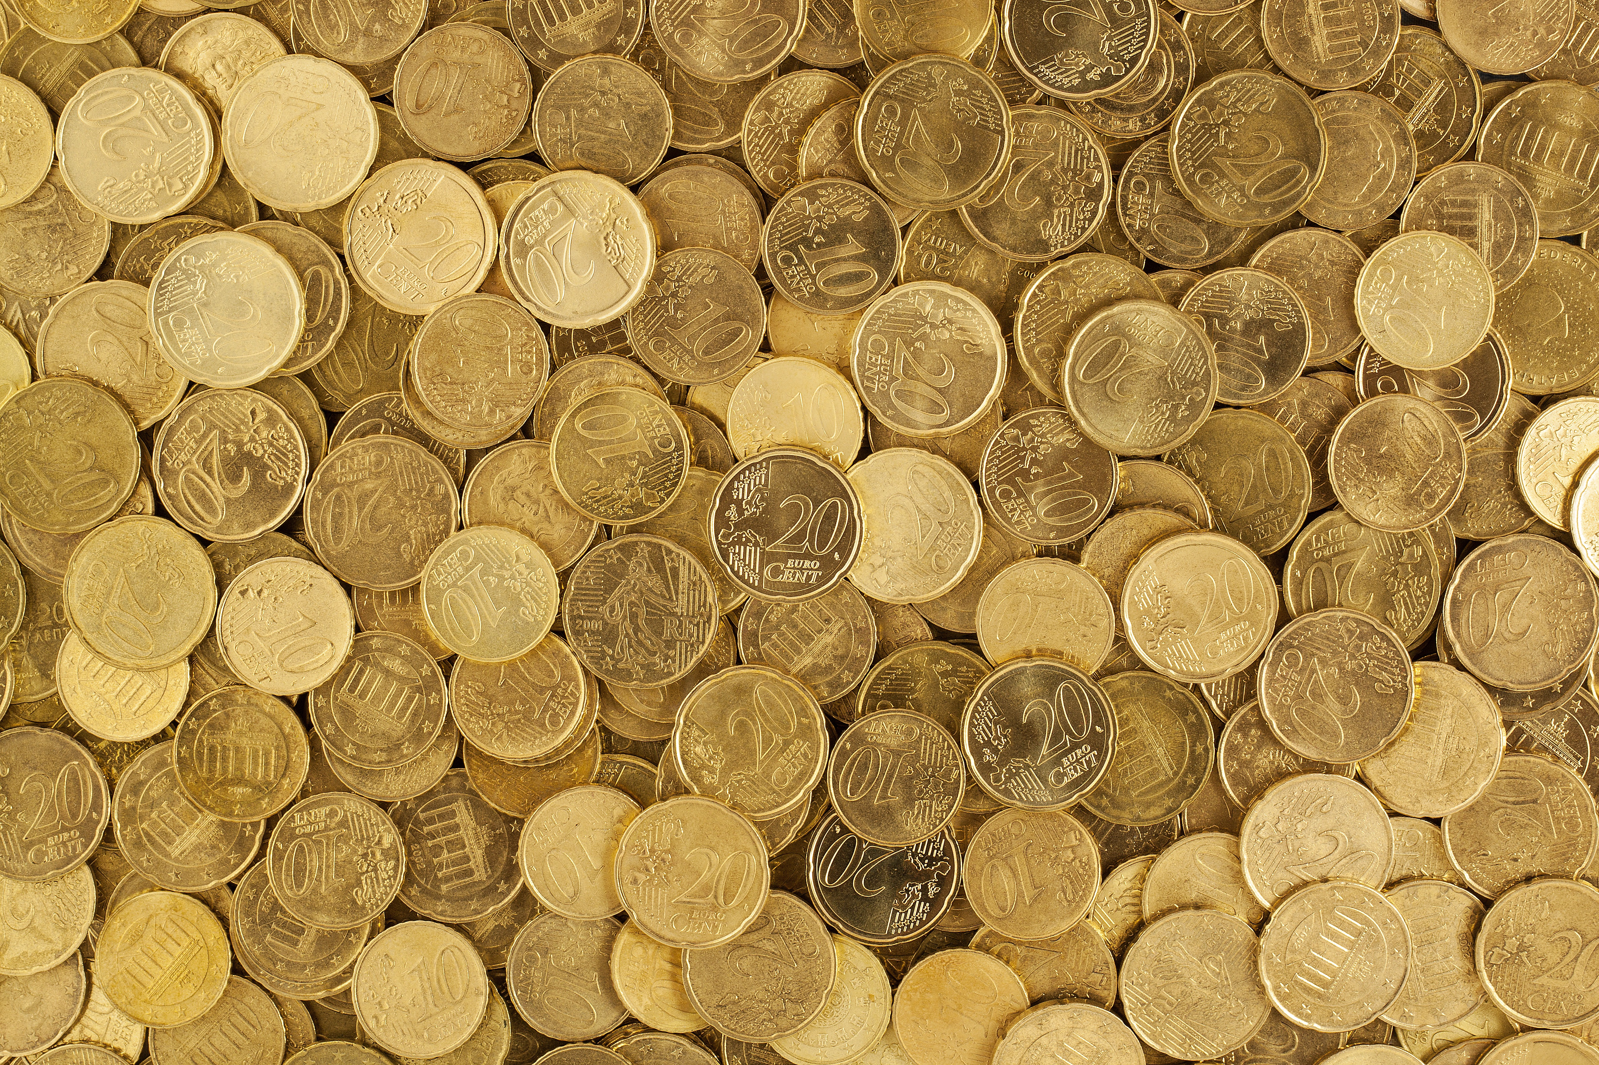

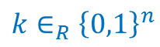







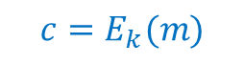



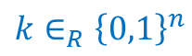
$$n$$
key
$$n$$
plaintext
$$k∈_{R}{\left\{0,1\right\}}^{n}$$
$$k∈_{R}{\left\{0,1\right\}}^{n}$$
ciphertext
$$ℓ(n)$$
$$E$$
$$C(n)$$
$$D$$
$$ℓ(n)$$
$$m∈{\left\{0,1\right\}}^{ℓ\left(n\right)}$$
$$c∈{\left\{0,1\right\}}^{C\left(n\right)}$$
$$m∈{\left\{0,1\right\}}^{ℓ\left(n\right)}$$
Encryption algorithm
Decryption algorithm
$$c=E_{k}(m)$$
$$m=D_{k}(E_{k}\left(m\right))$$

Slide 2
